Slide 1
Employee Data Analysis using Excel
STUDENT NAME: Sanjay kumar. S
UNIVERSITY REGISTER NO:312206461
NAN MUDHALVAN ID: unm13012221166/DBFA1CAE480F004A75C4887F8A37DADD
DEPARTMENT: Commerce
COLLEGE; A.M JAIN COLLEGE, CHENNAI

Slide 2
PROJECT TITLE
Employee Performance Analysis using Excel

Slide 3


AGENDA
Problem Statement
Project Overview
End Users
Our Solution and Proposition
Dataset Description
Modelling Approach
Results and Discussion
Conclusion
3/21/2024 Annual Review

Slide 4

PROBLEM STATEMENT employee performance is used for evaluating how well employees are meeting their job responsibilities and contributing to the organisation This process helps identify strengths and areas of improvement informs decisions on promotions, rewards, and training needs, and aligns individual performance with the company

Slide 5

PROJECT OVERVIEW Analysing the performance of the employees by rating salary for analysing the employees strength and area of performance. It focus on evaluating and understanding the effectiveness, efficiency and productivity of employees within an organisation
.

Slide 6

WHO ARE THE END USERS? Employer employee organisation HR

Slide 7

OUR SOLUTION AND ITS VALUE PROPOSITION charts- visualization, reports pivot table- summary

Slide 8
Dataset Description employee dataset- kaggle 26 features I have used 9 features employee id- numerical name- text salary- numerical gender -text rating-numerical performance-text business unit-text business type-text

Slide 9

THE "WOW" IN OUR SOLUTION The solutions are used for different things like improves performance This also increases employee satisfaction
3/21/2024 Annual Review
9

Slide 10
MODELLING
data collection using kaggle the data is collected feature collection using the various features in excel the features are used Data cleaning blanks columns are being deleted performance level performance level are shown using charts
10

Slide 11
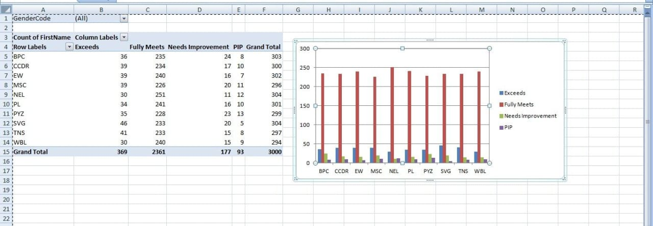
RESULTS
11

Slide 12
Conclusion The Employee Performance Analysis project is a critical initiative that helps organizations optimize their human resources, ensuring that employees are not only meeting their objectives but also contributing to the company's overall success. By systematically evaluating and enhancing employee performance, organizations can drive continuous improvement and maintain a competitive edge.

